Slide 1
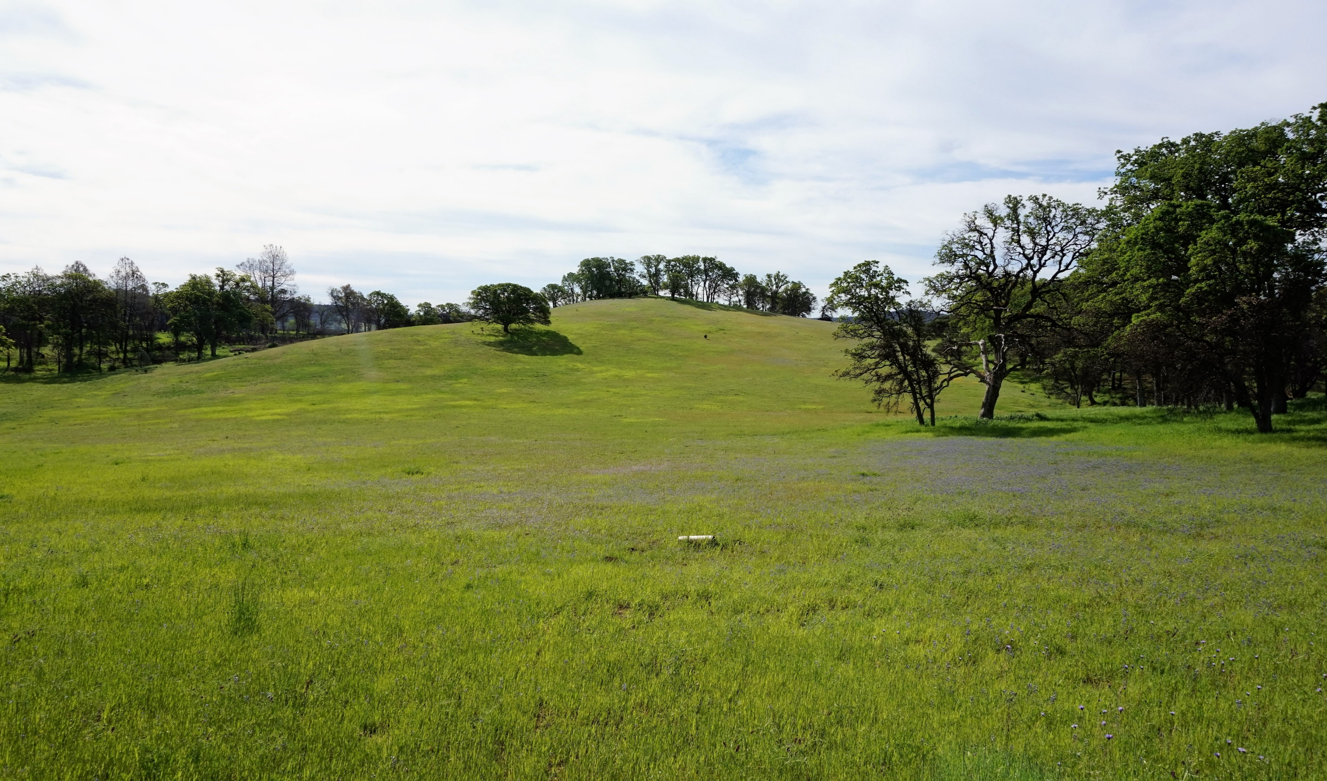
Nitrogen enrichment effects on grassland plant diversity are dependent on spatial scale
Evan Batzer and Valerie Eviner
University of California, Davis
COS 54 - Biodiversity II
8/8/2018

Slide 2
Introduction
Nitrogen enrichment is widely recognized as a driver of global biodiversity loss
Alters patterns of resource limitation that increases productivity and often produces a shift in limiting resources from nitrogen to light
May also reduce community biodiversity through environmental homogenization that limits opportunity for spatial coexistence
Ability to detect this change depends on the scale of sampling
Sala et al. (2000) Science

Slide 3
Scale Dependence
Constant Effect
Diversity
Control
Concerns of scale are persistent in ecology (Levin 1992)
Many experiments conducted at small scales (1m² or less)
More nuanced insights may come from cross-scale analysis
Treatment
Effect Diminishes With Scale
Diversity
Control
Treatment
Inverted Effects
Diversity
Control
Treatment
Sampling Effort

Slide 4
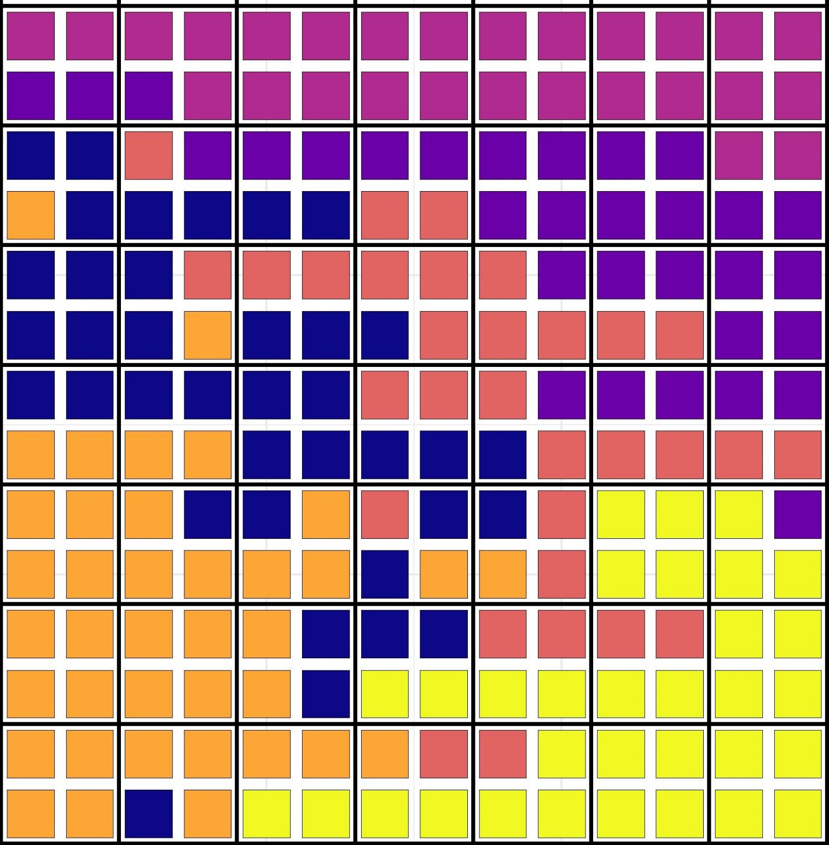
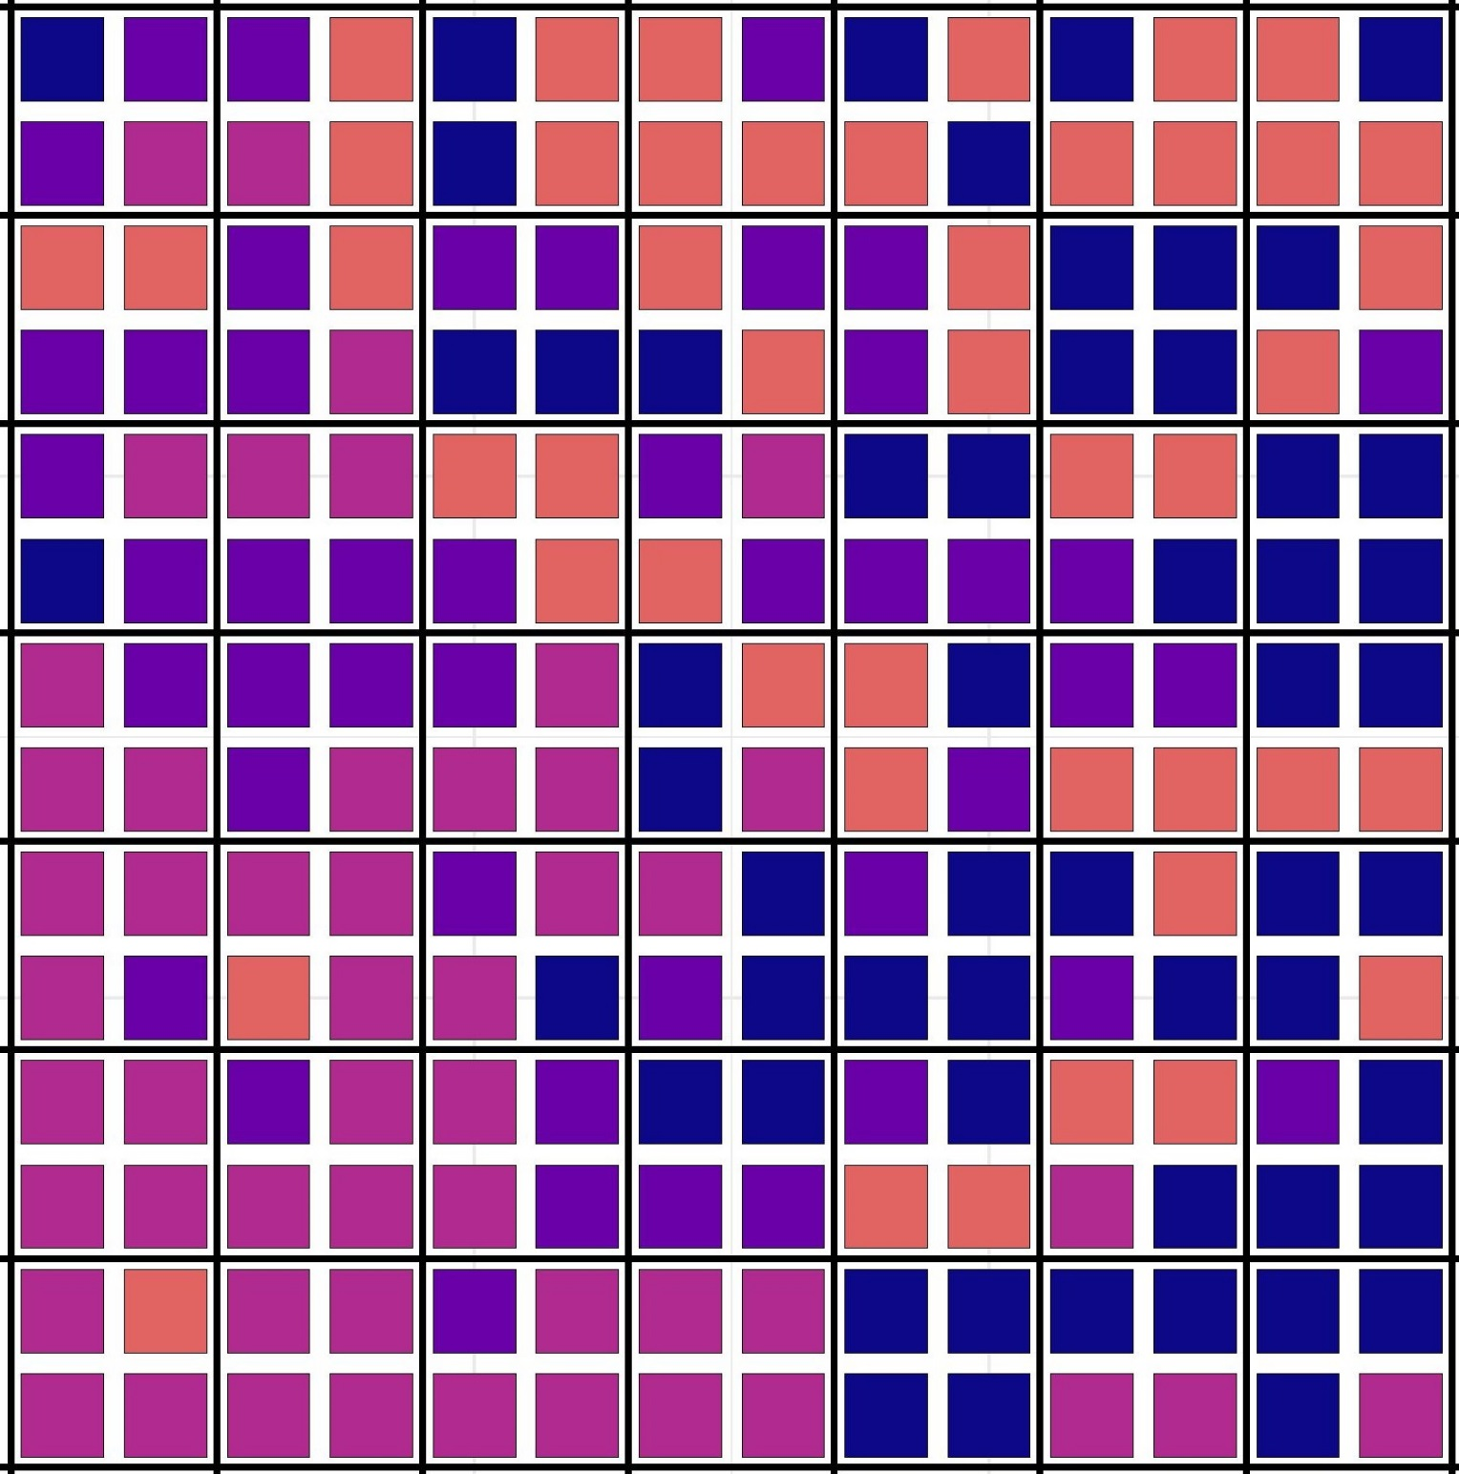
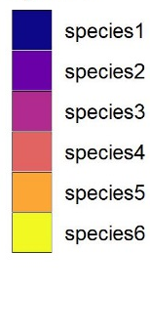
Example: N enrichment affects both diversity and spatial pattern
Control
N_{species} = 6
Higher spatial aggregation
Treatment
N_{species} = 4
Lower spatial aggregation

Slide 5
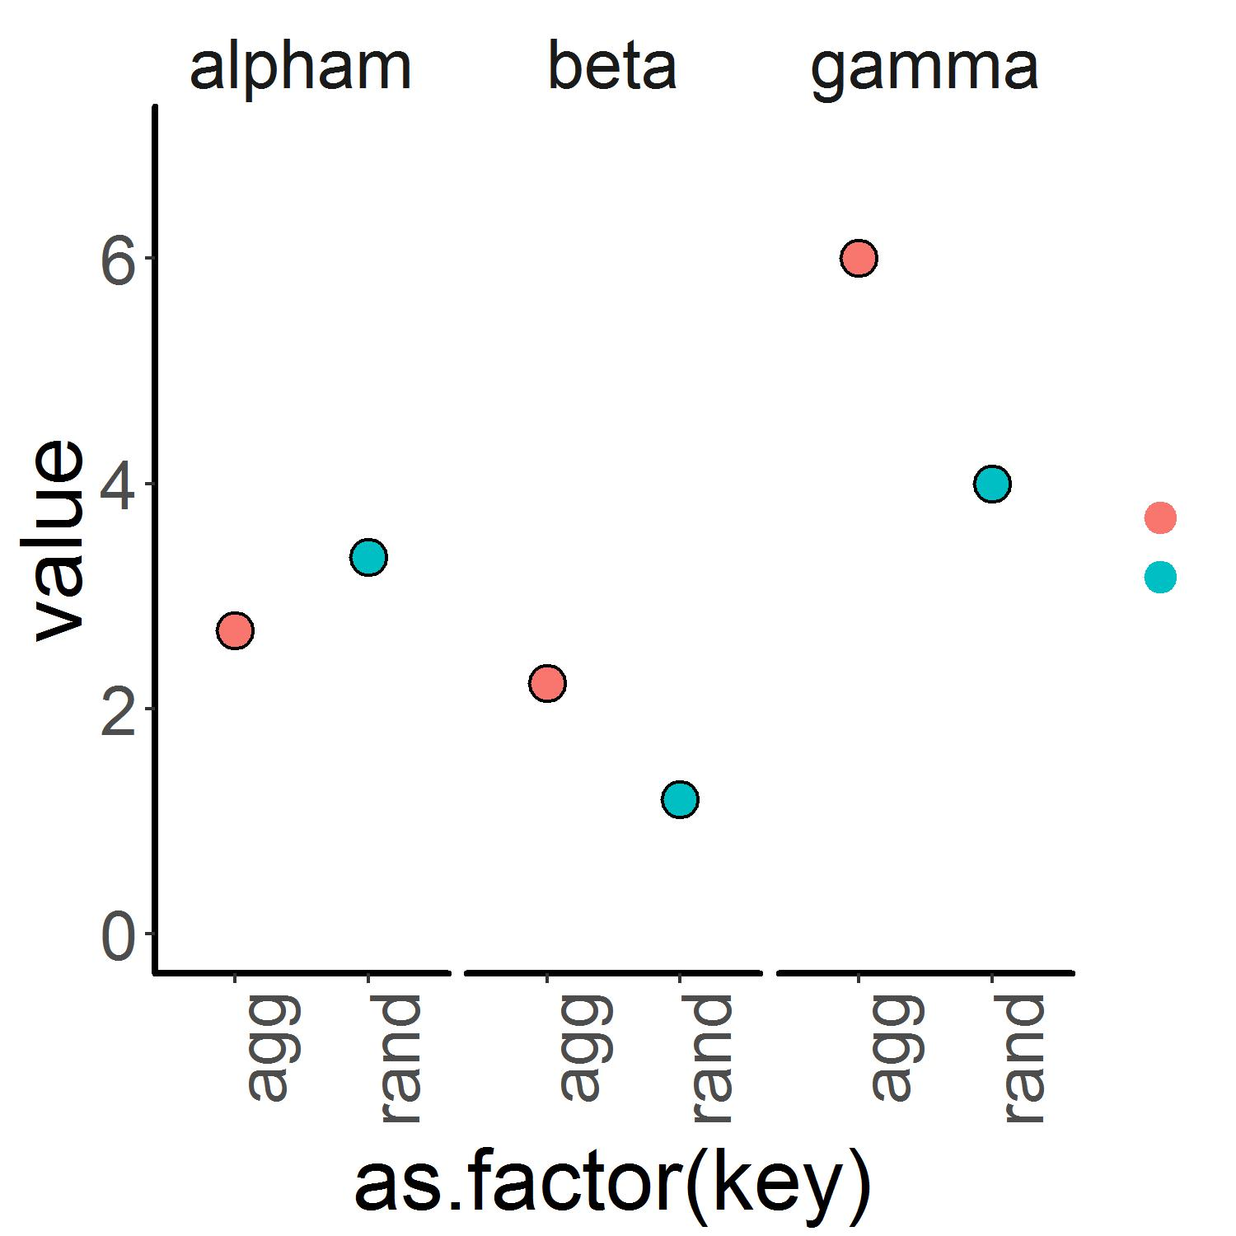

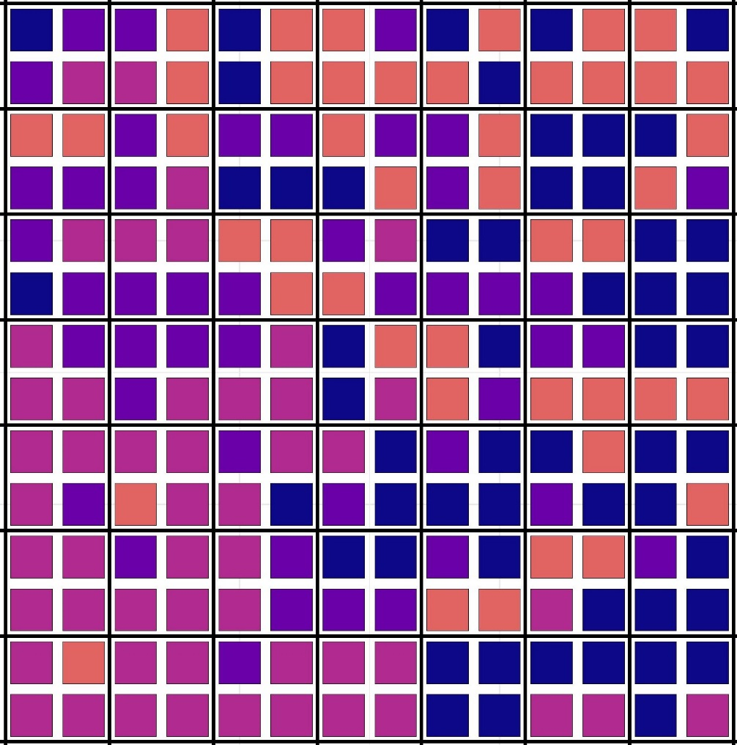
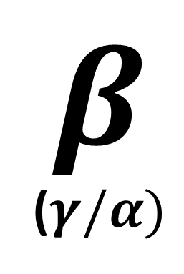


1
Control
+Nitrogen
Species Richness
2
$$α$$
$$γ$$
$$β$$
($γ/α)$

Slide 6
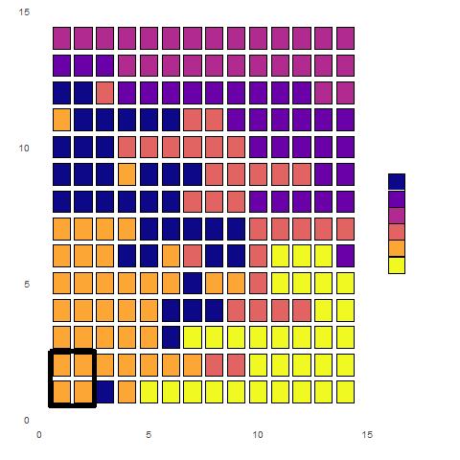
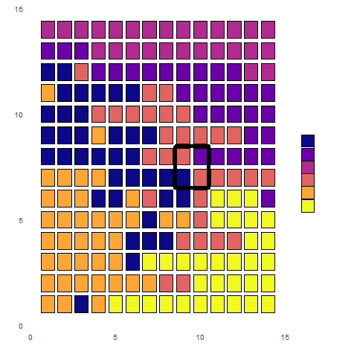
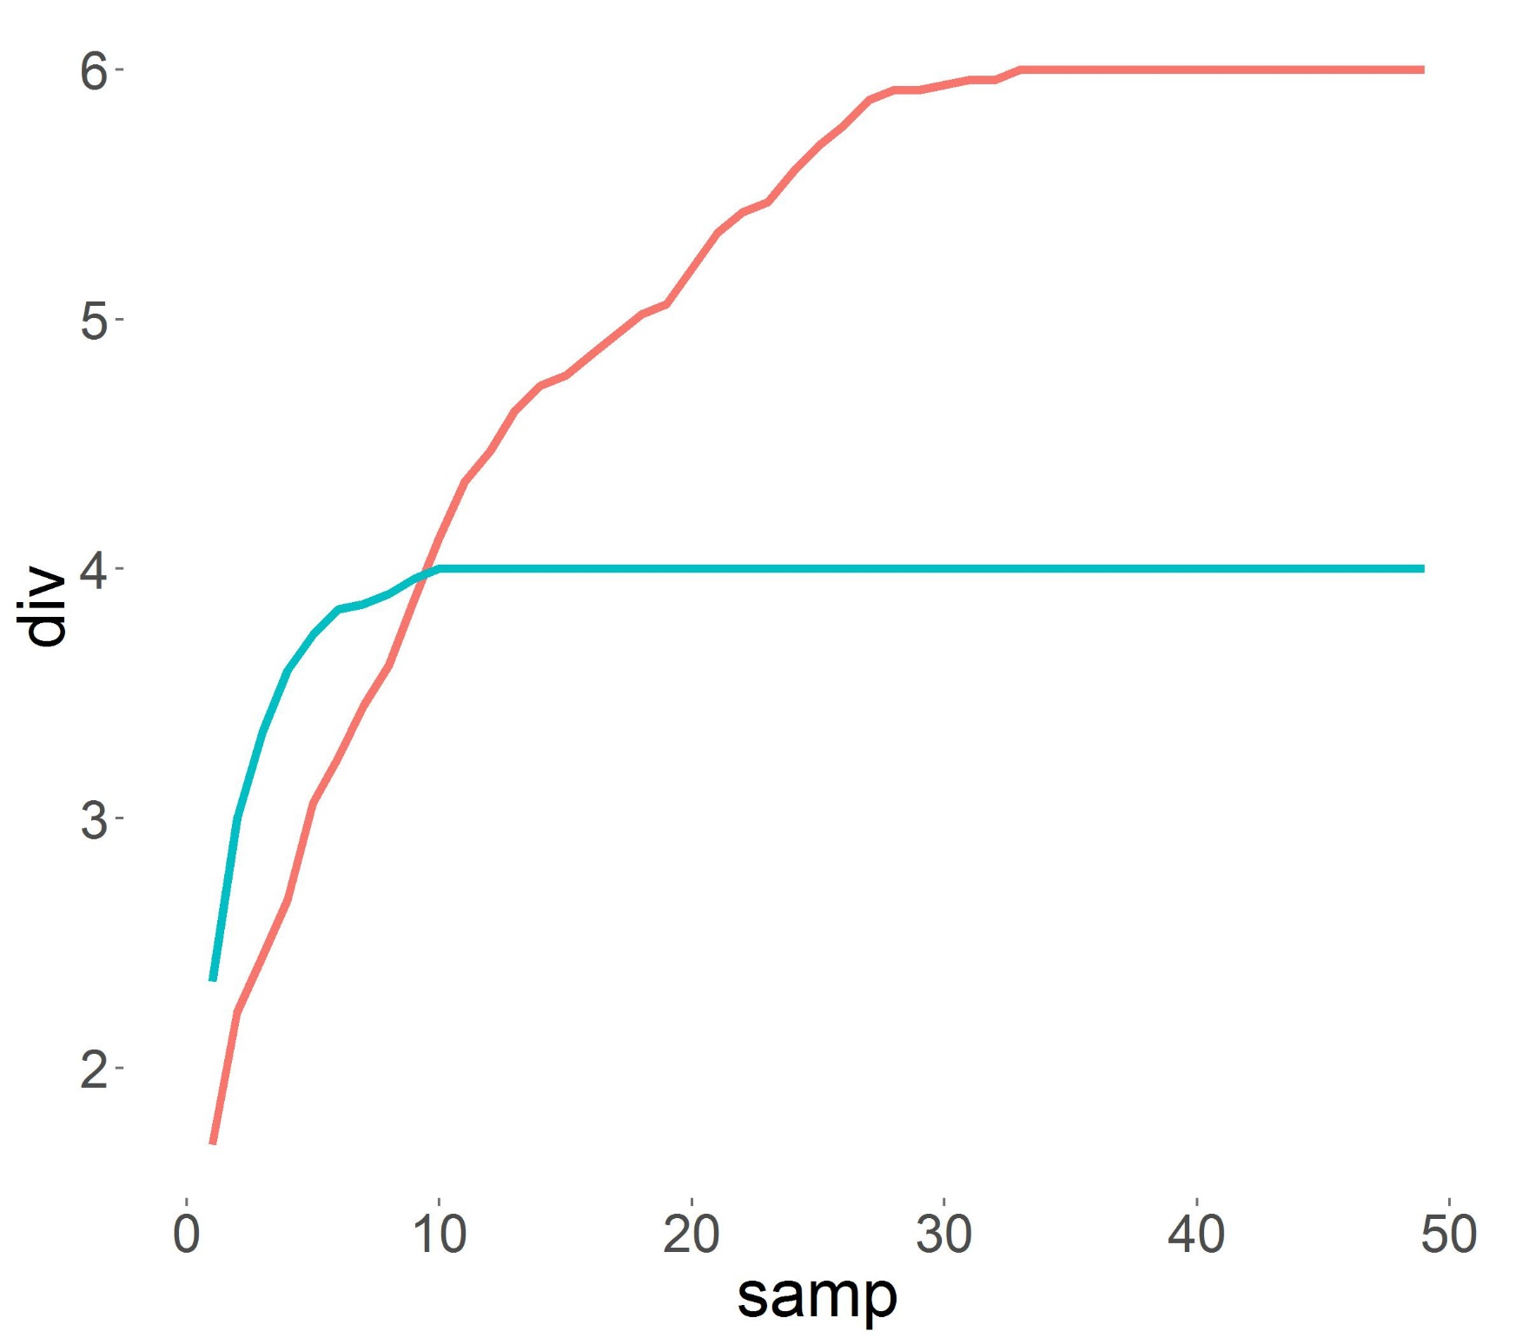
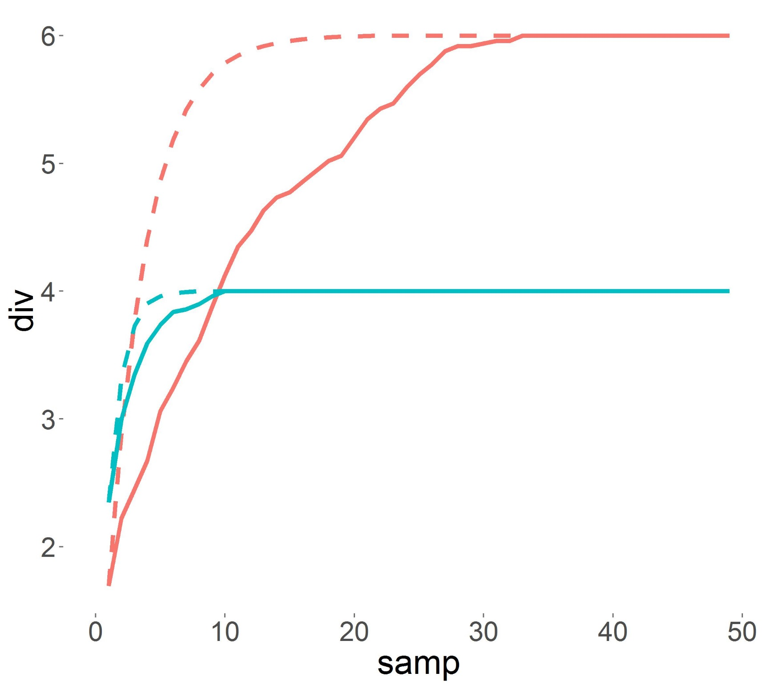
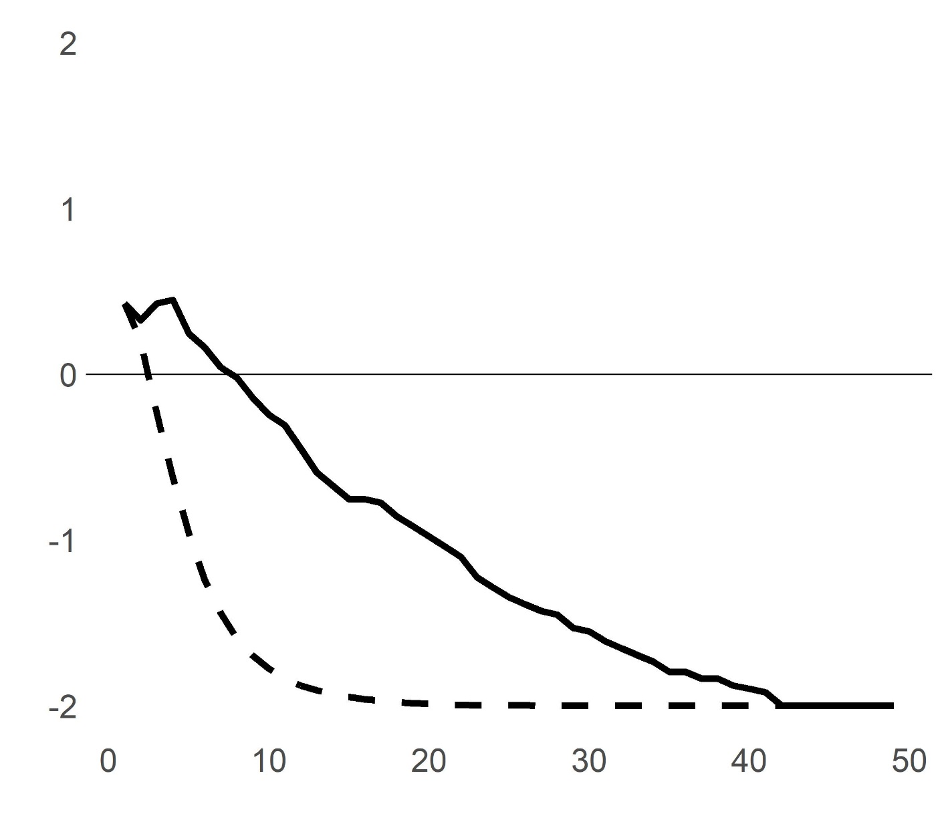
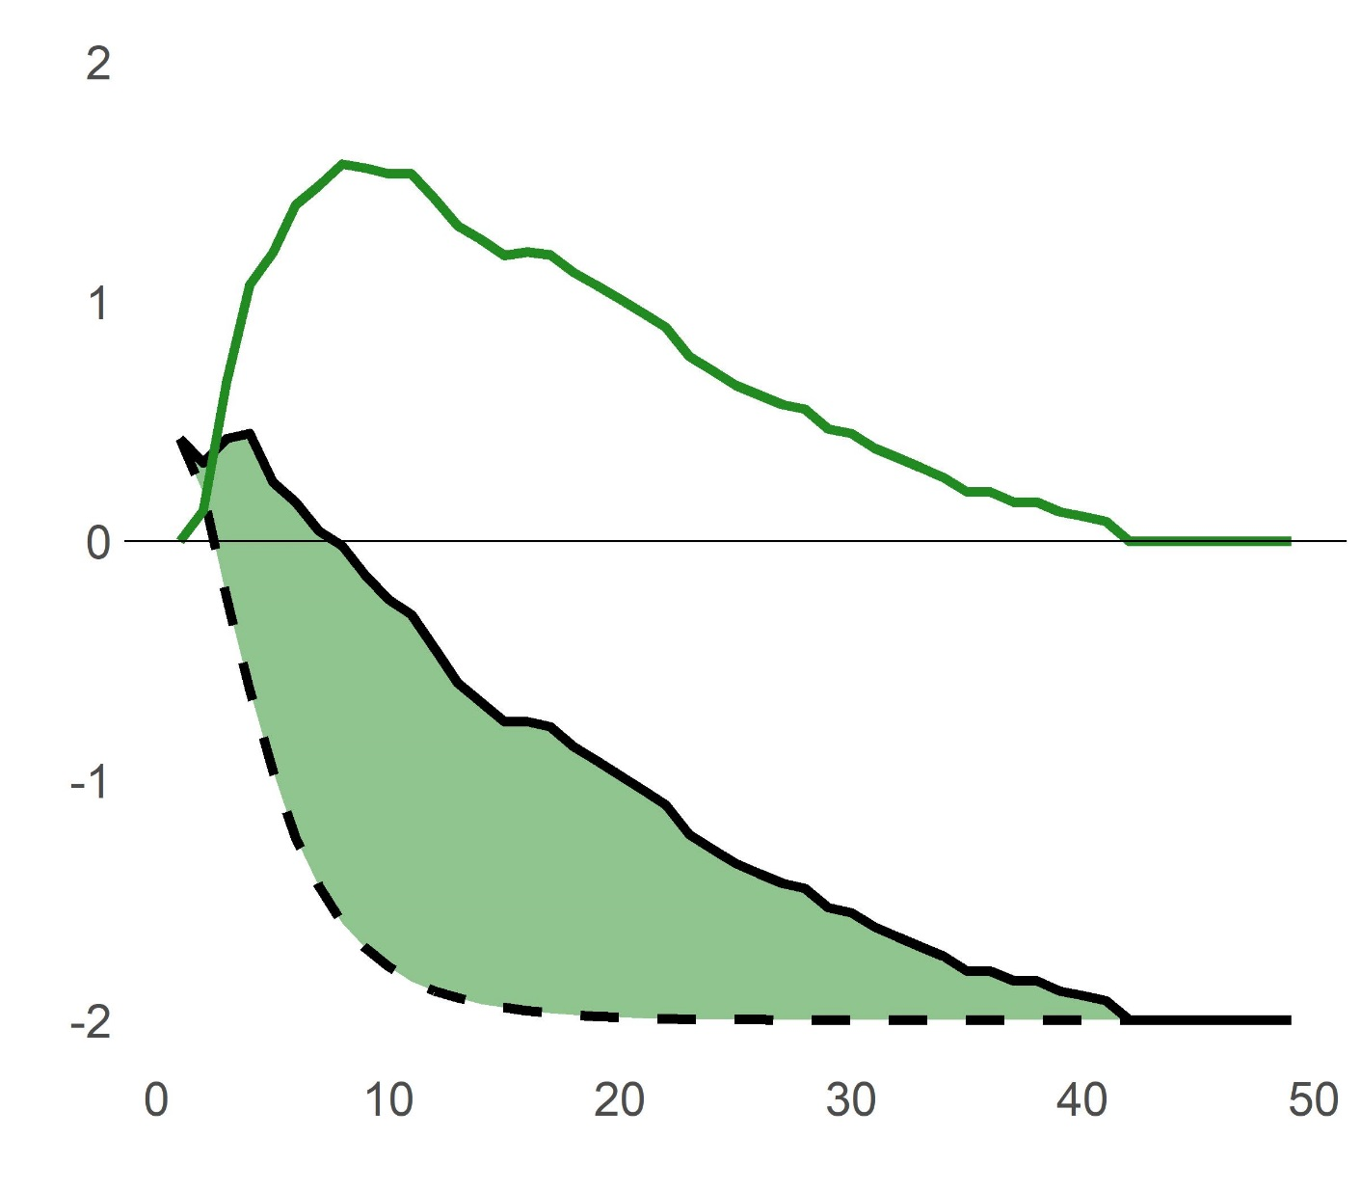
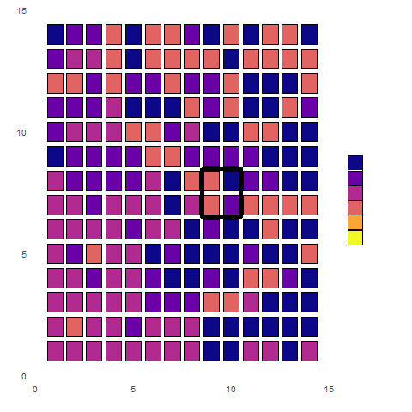
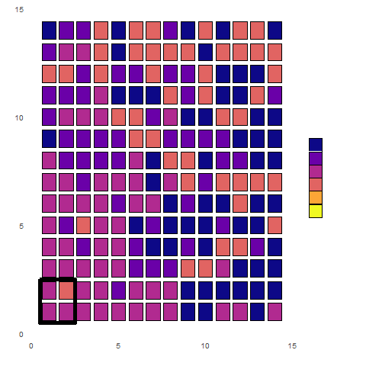
Control
Aggregation effect
1
Species Richness
Diversity Change
+ Nitrogen
Spatial rarefaction
Random rarefaction
Spatial rarefaction
Random rarefaction
Sample Number
Sample Number
Decomposition of these relationships through:
Explicit (spatially ordered) rarefaction
Random rarefaction
Aggregation effect
2

Slide 7
f
Questions
Are effects of nitrogen enrichment dependent on the spatial scale of sampling? Does this interpretation vary between species richness and abundance-weighted metrics?
How does interpretation of effects vary between richness and abundance-based metrics?
How does nitrogen enrichment affect community spatial pattern?

Slide 8
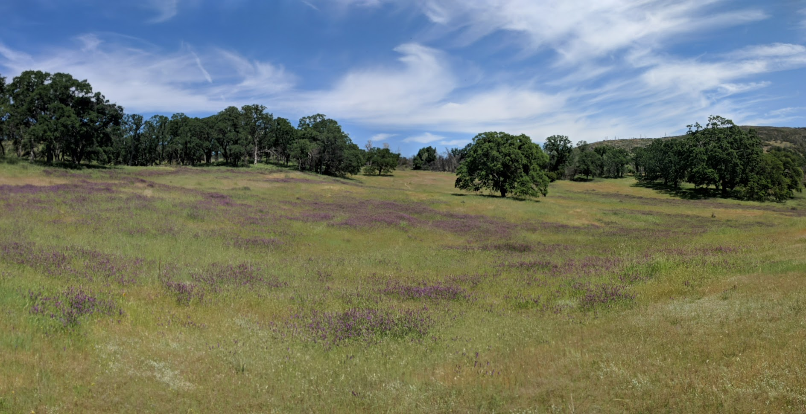
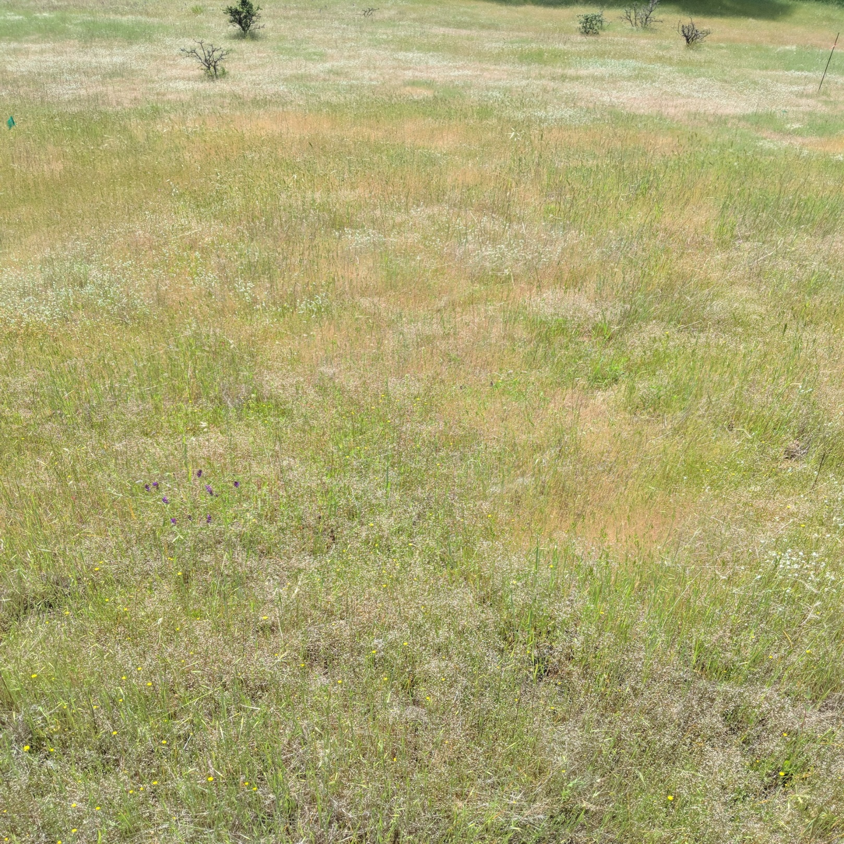
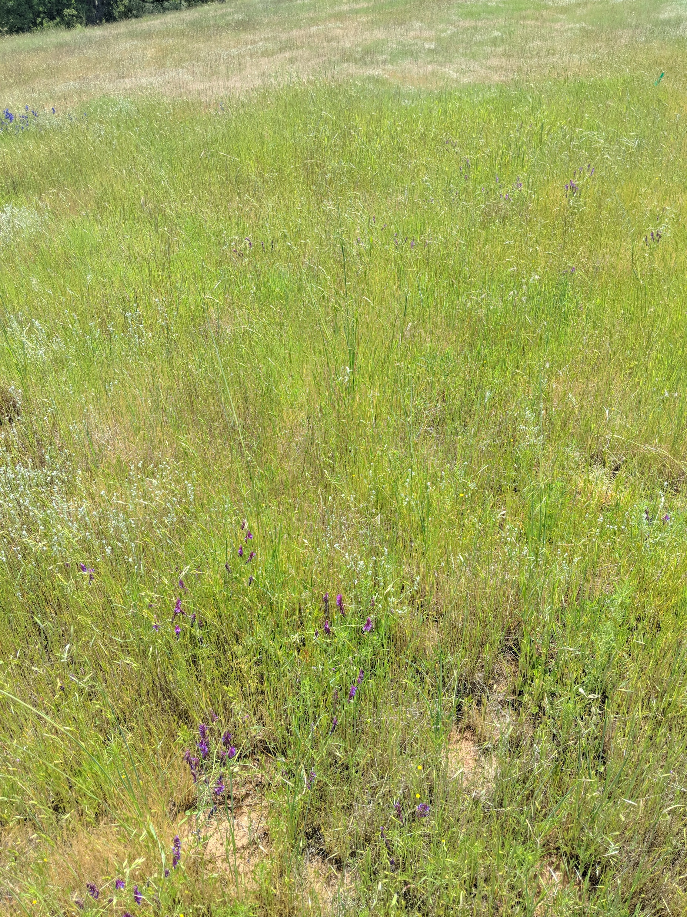
California Annual Grasslands
Control
+ Nitrogen

Slide 9
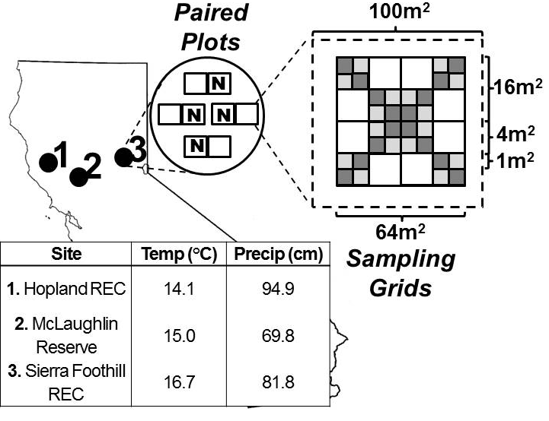
Study Design
3 Sites
Hopland Research and Extension Center
McLaughlin Natural Reserve
Sierra Foothill Research and Extension Center
4 blocks per site (12 blocks total)
2 paired plots per block (24 plots total)
Plot area 100m² (10m x 10m)
64 sampling subplots per block
Subplot area .25m² (.5m x .5m)
1m interval between subplots
Sampling extent 64m² (8m x 8m)
Fertilization treatment
Randomly assigned to 1 plot per block
Slow-release urea fertilizer, 10g N/m²
Applied in January – February 2017, 2018
Sixty-four .25m² subplots within a 64m² plot (1m spatial lag)
Application of slow-release urea fertilizer at rate of 10g N / m² applied in winter 2017, 2018.
Diversity Change
Visual estimates of compositional diversity and percent cover in April – July
Light Availability
PAR measurements above and below grass “canopy”
Biomass
Ten 10cm x 100cm strips per plot per year.

Slide 10
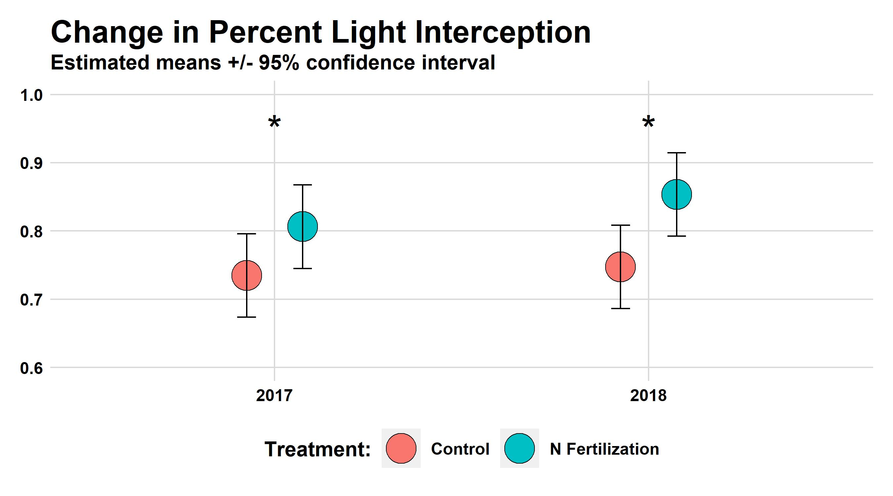

Slide 11
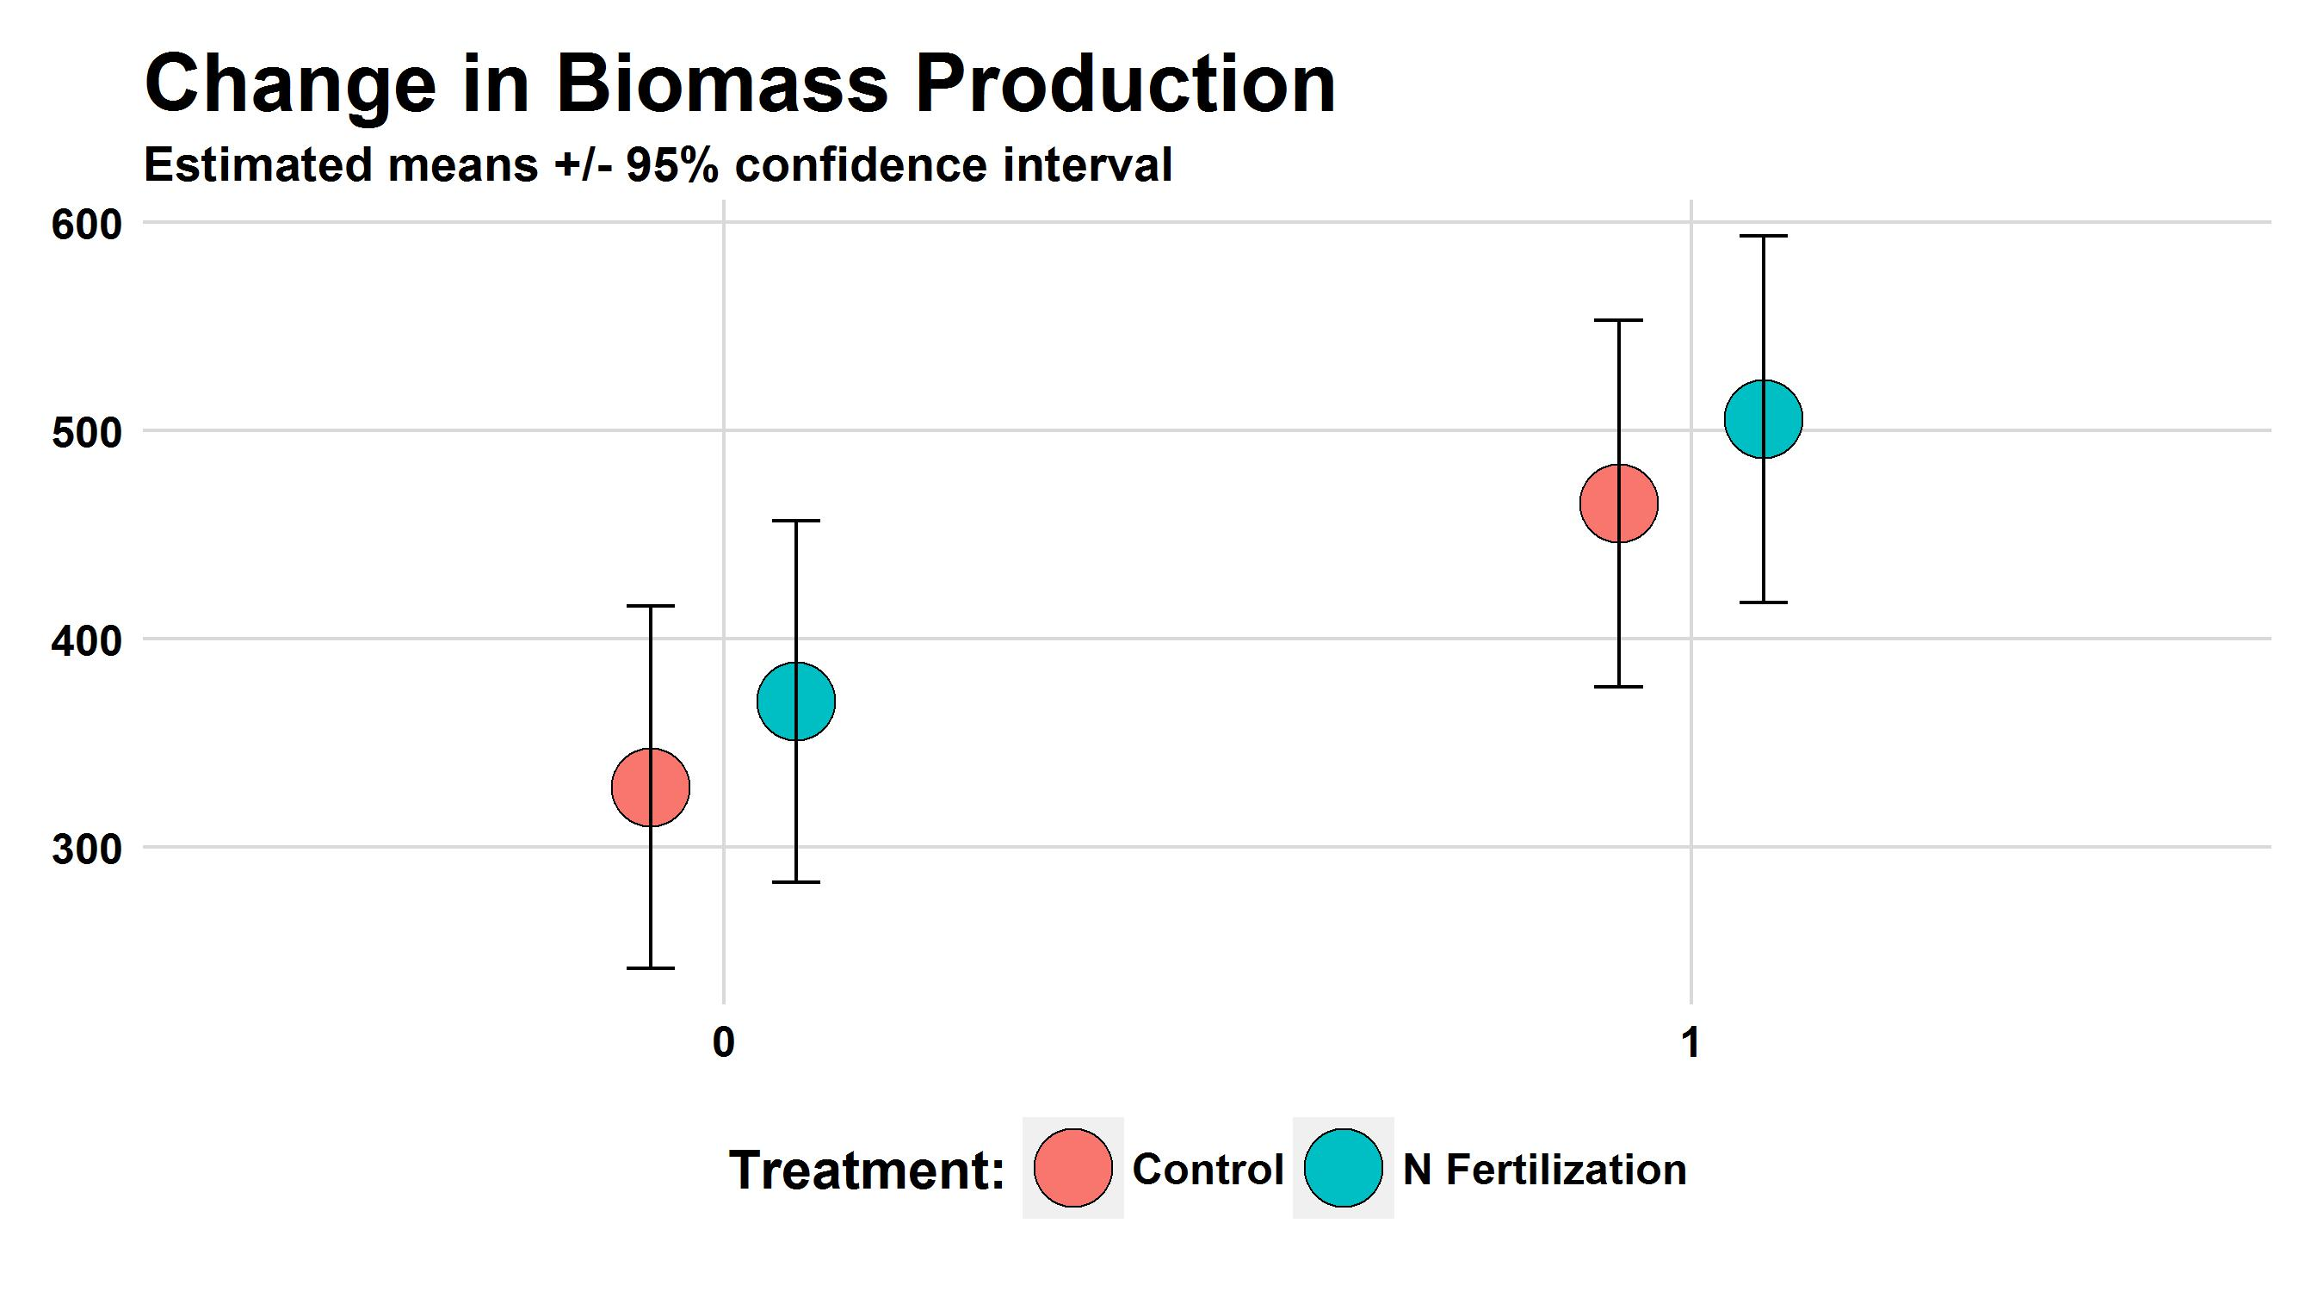

Slide 12
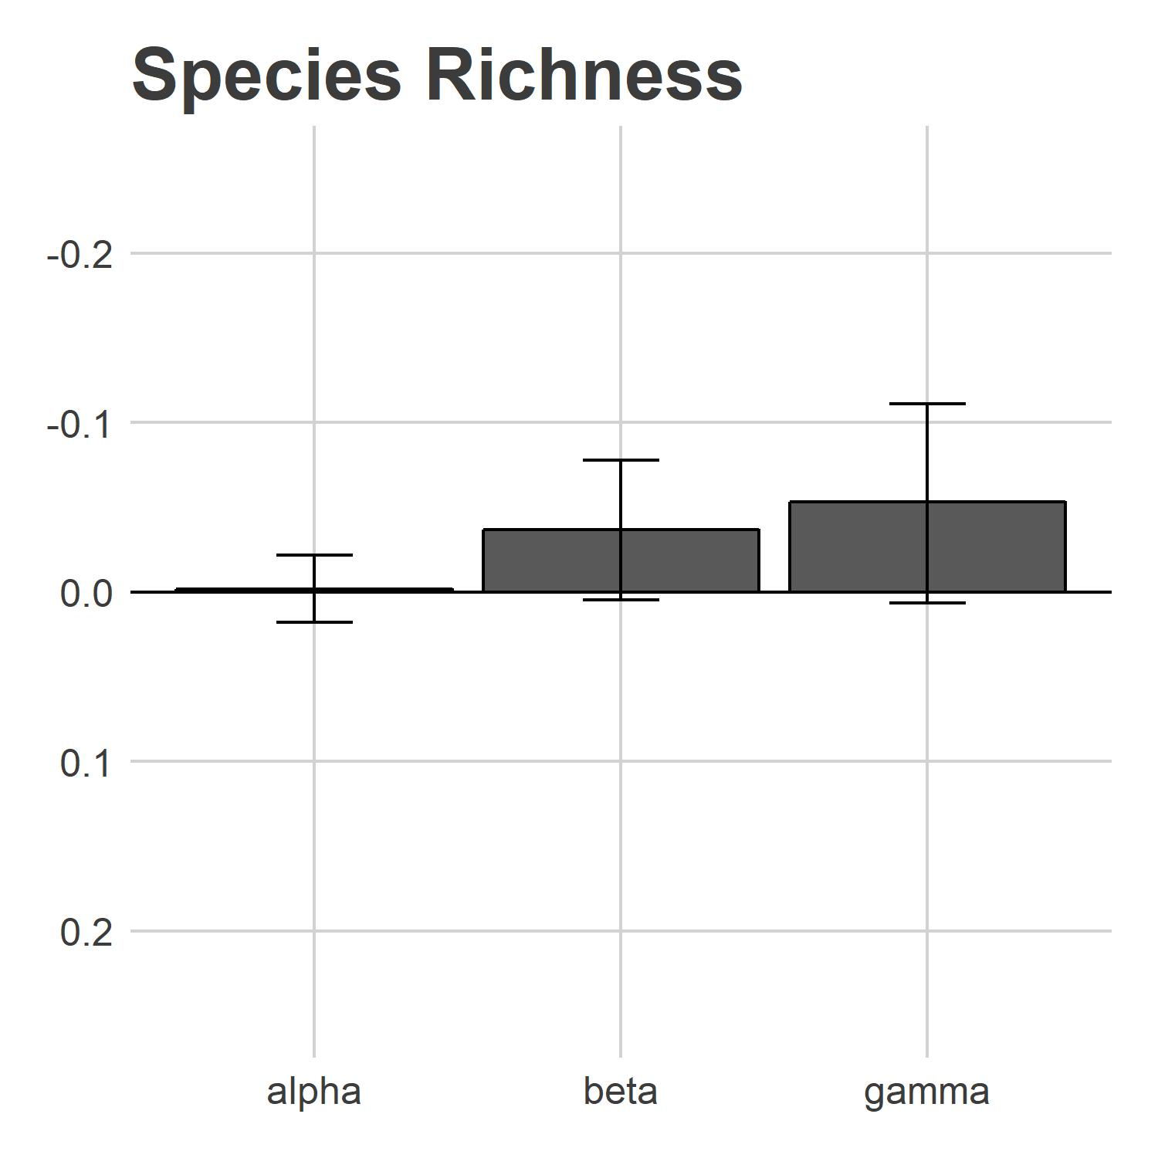
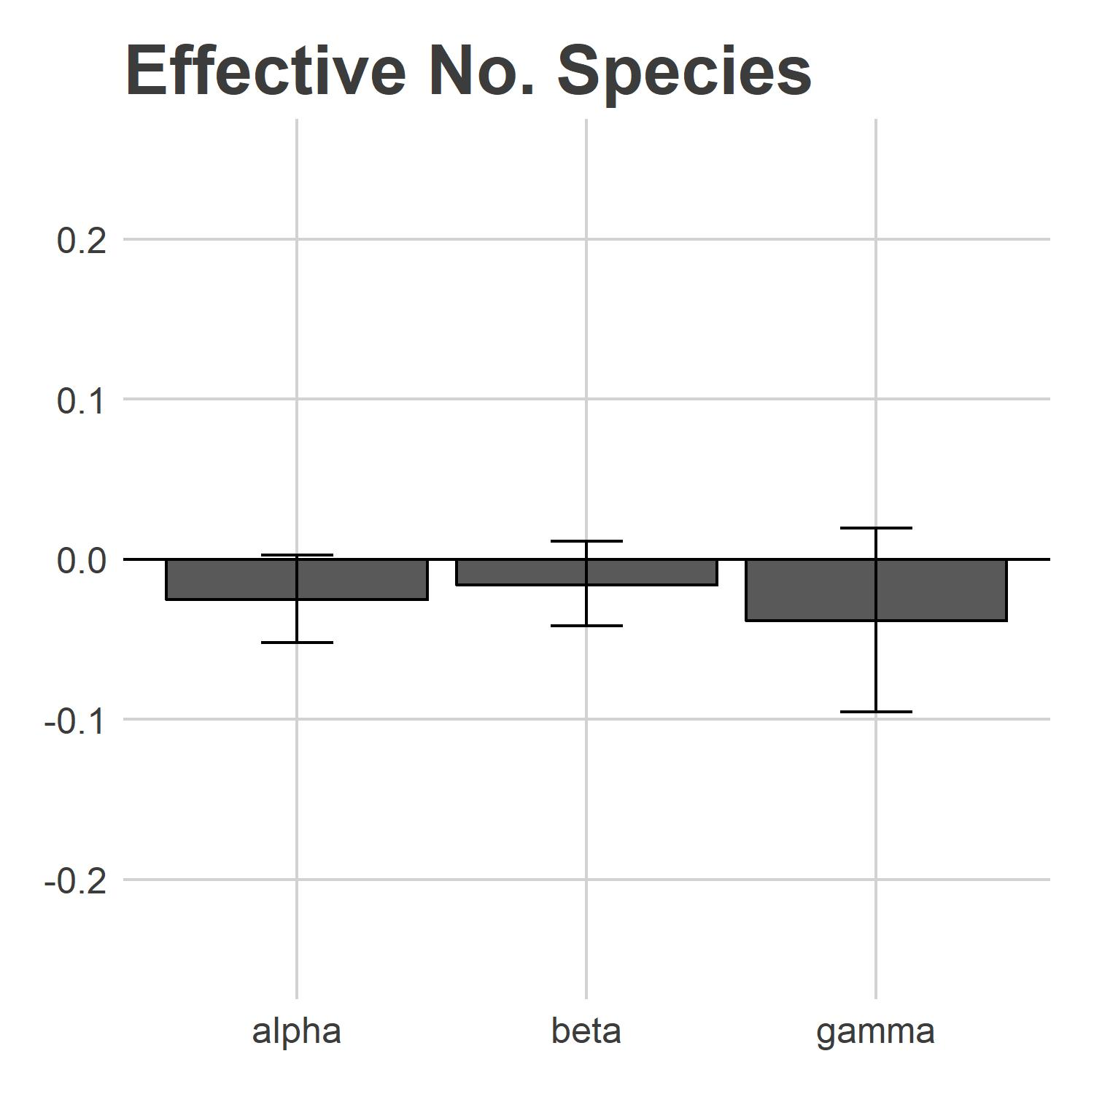
Diversity Change - 2017
Proportion change

Slide 13
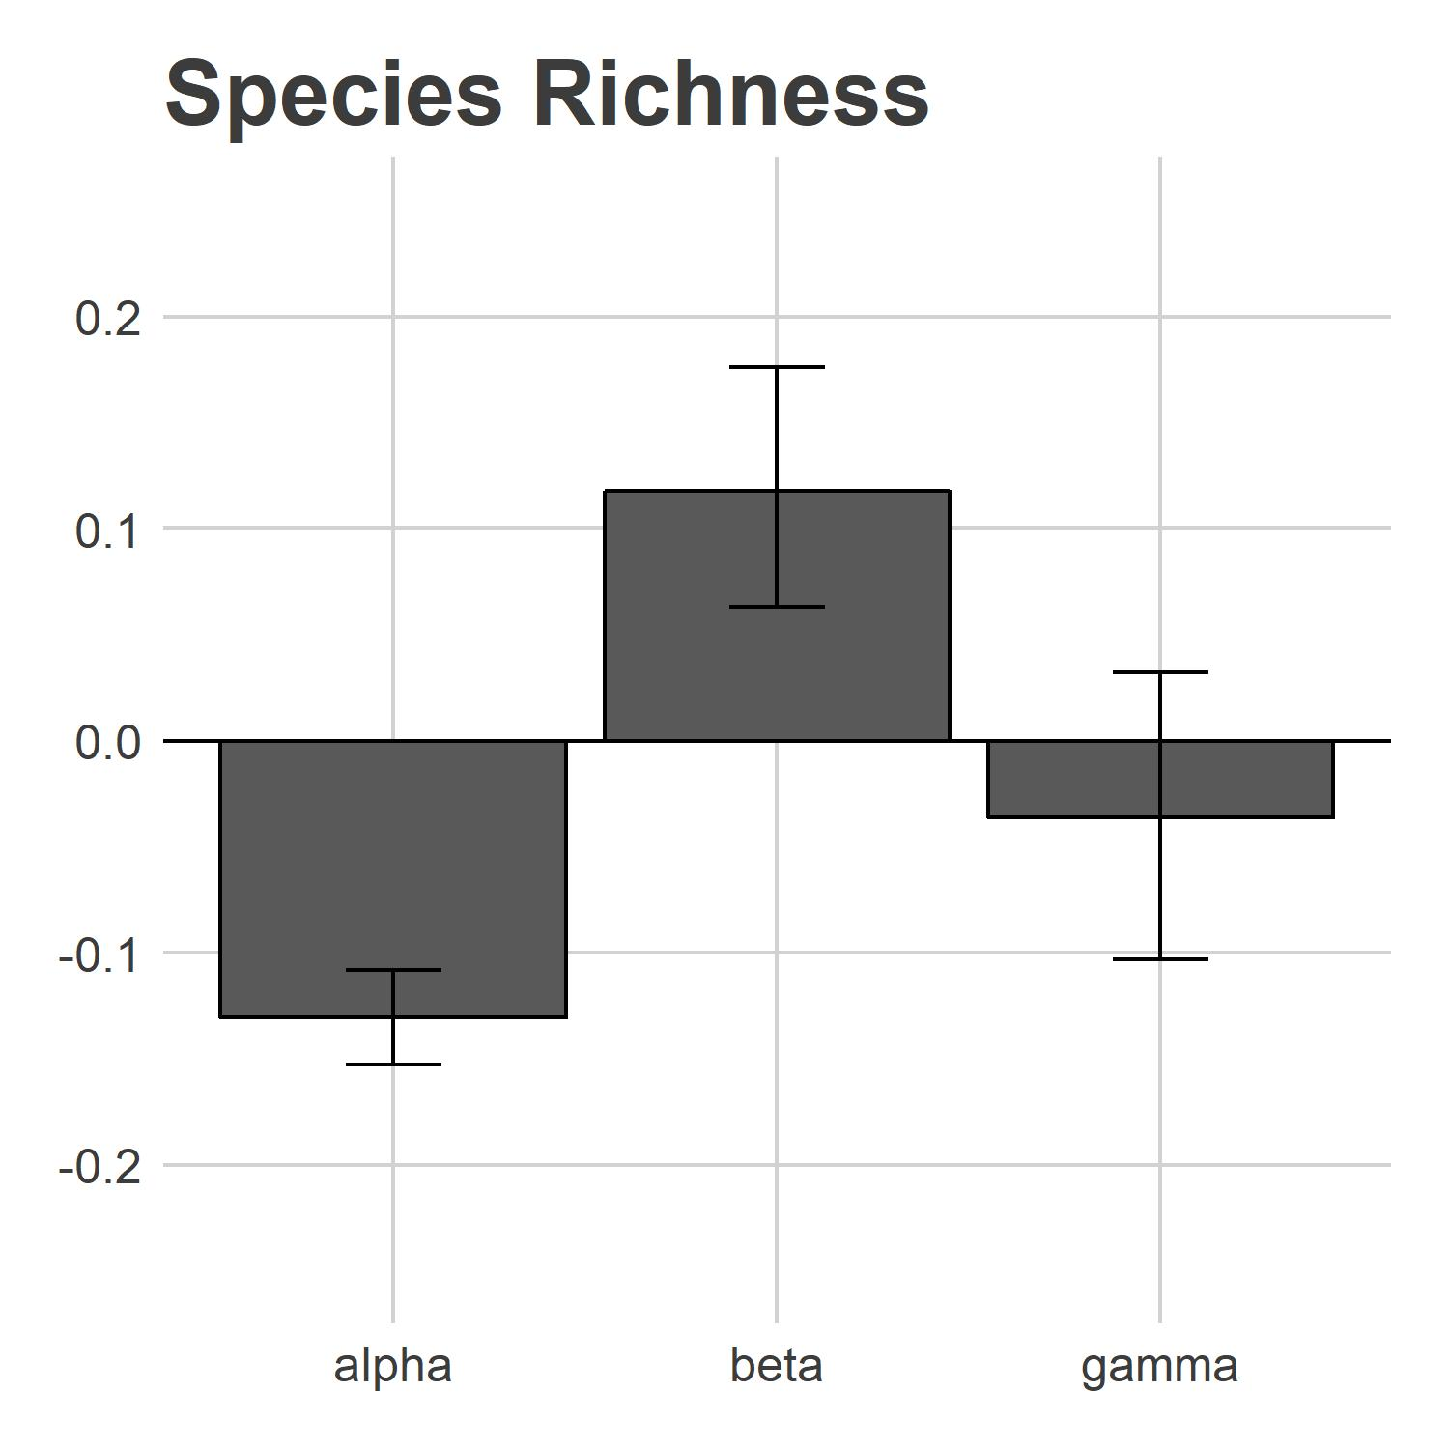
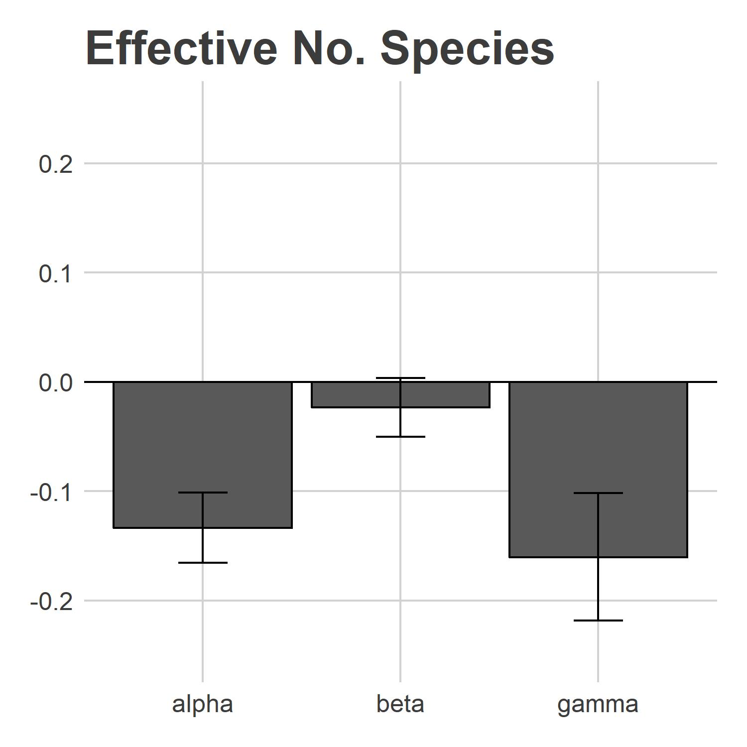
Diversity Change - 2018
*
*
*
*
Proportion change

Slide 14
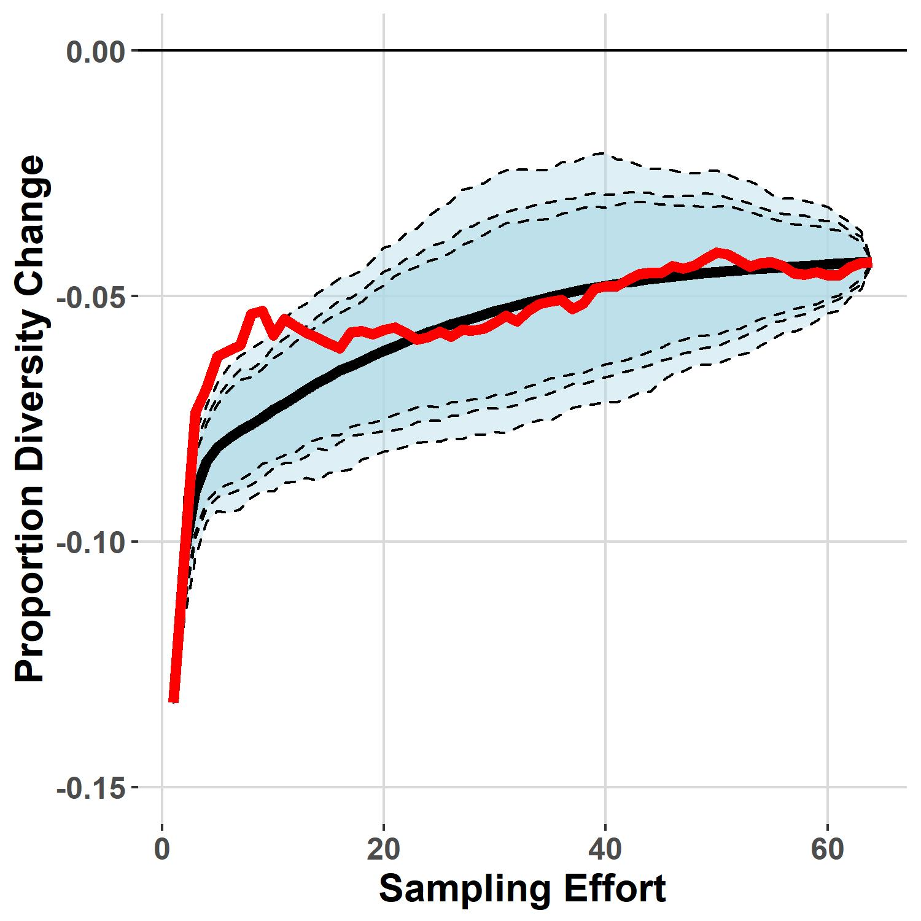
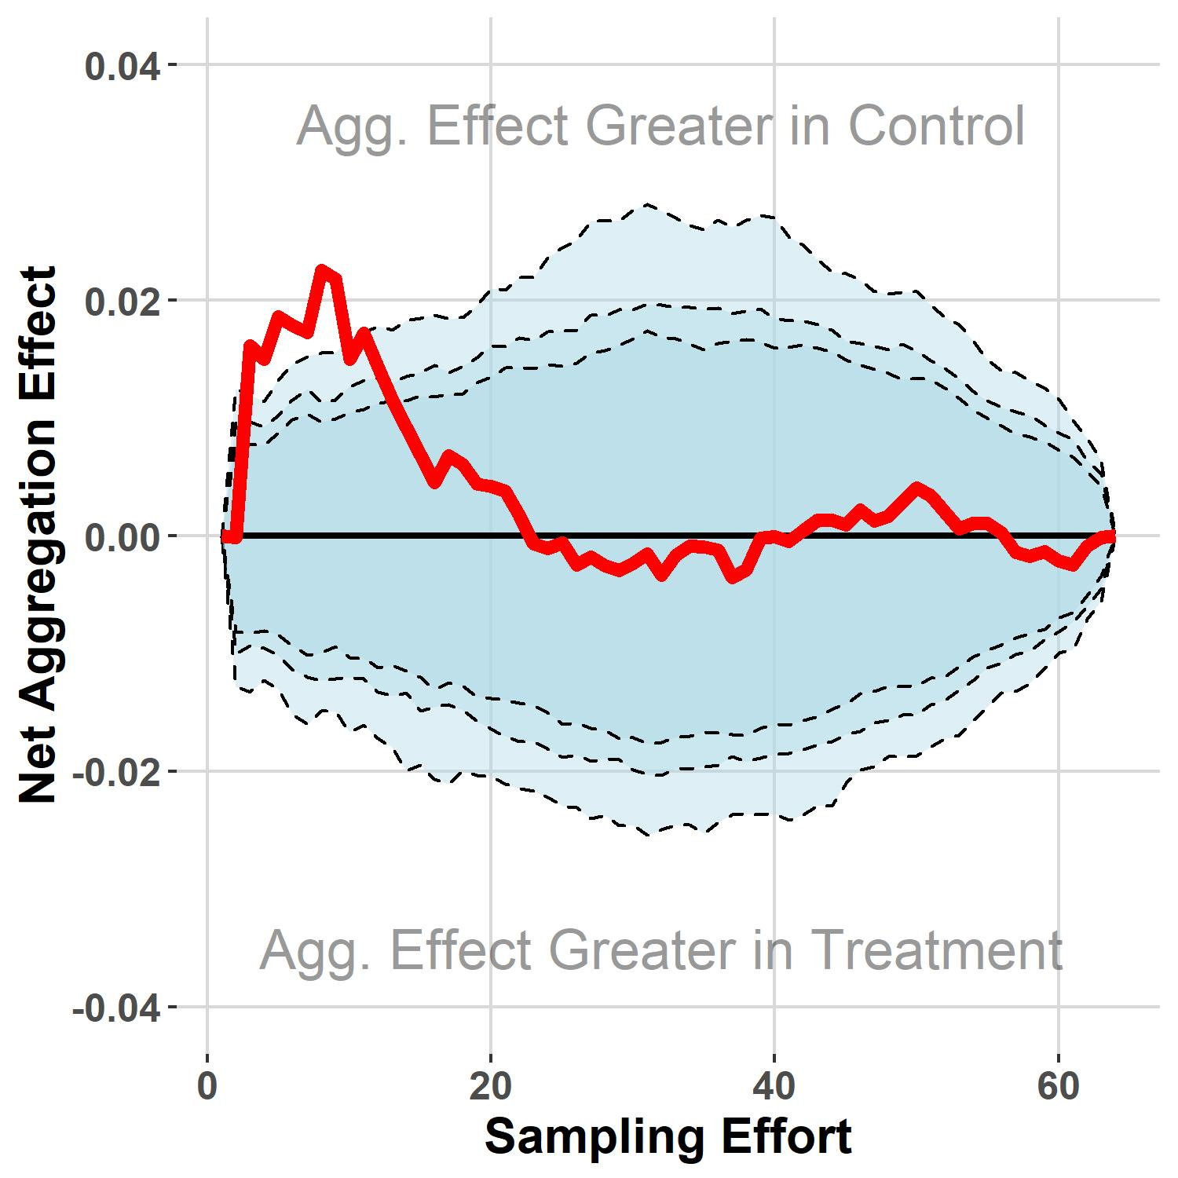
Accumulation Curve Decomposition
Species Richness

Slide 15
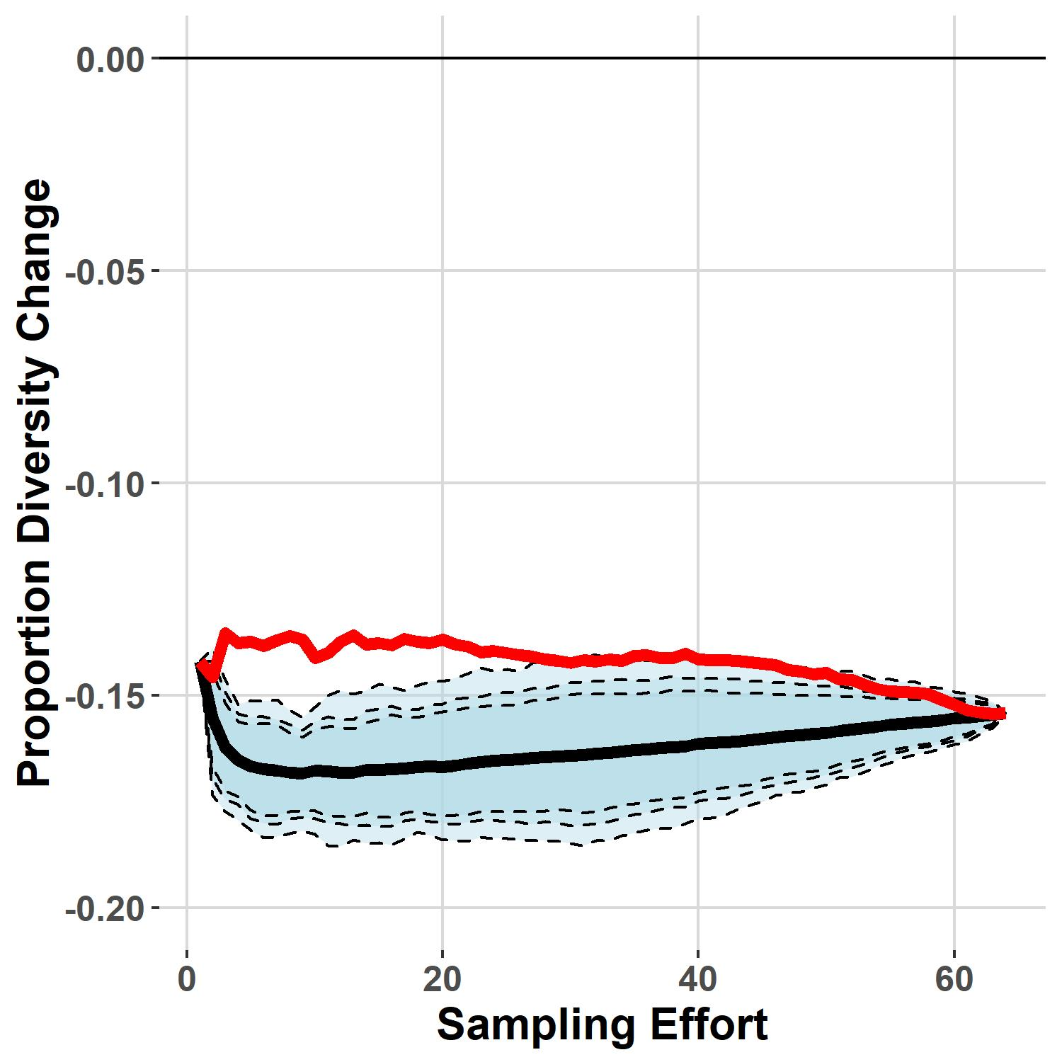
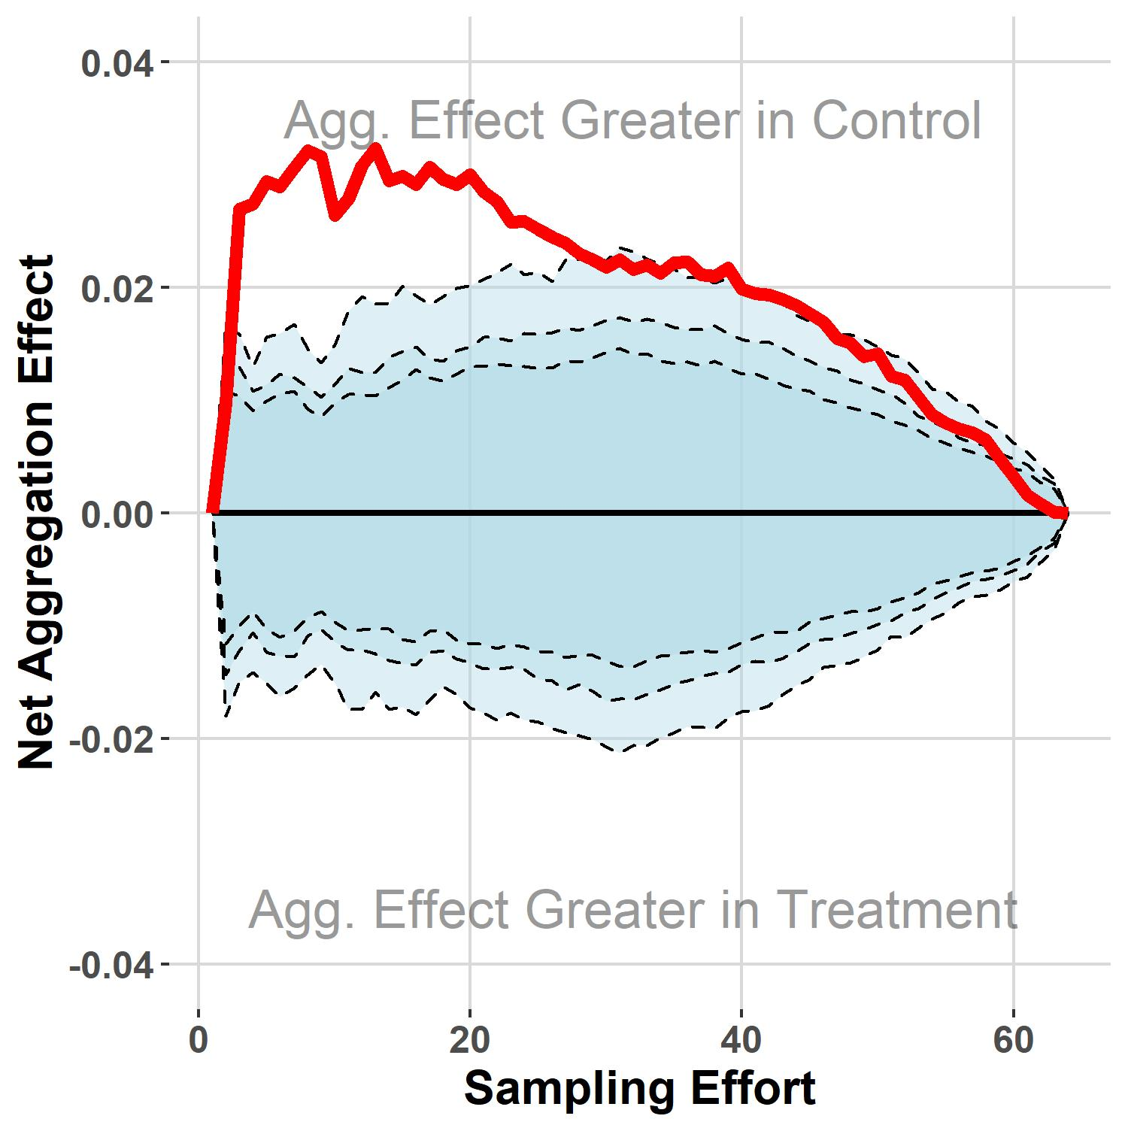
Accumulation Curve Decomposition
Effective No. Species

Slide 16
Conclusions
Scale-dependent effects of N enrichment depend on sampling metric used:
Failure to produce significant richness declines at larger scales
Consistent reduction in abundance-weighted diversity
Spatial homogenization in response to N enrichment
Potential changes to ecosystem function independent of biodiversity loss

Slide 17
Acknowledgements

